Slide 1
Practical IoT
IoT for smart cities, manufacturing, and Analytics from scratch

Slide 2



Agenda
Noon – 1 : Defining “Smart” – Intro and lecture
1 – 2: LUNCH
2 – 4: Building Smart Tech – hands-on

Slide 3


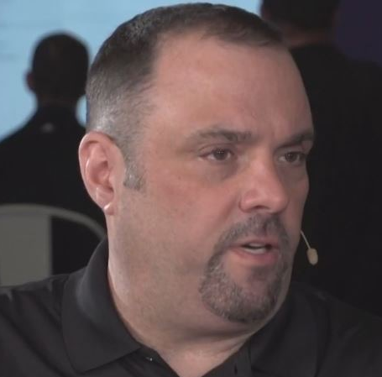

Quick Intro
Louis Frolio - @froliol
Technical Evangelist
IBM Cloud and Cognitive
US Coast Guard veteran
Master Chef
Chris Harrold - @charrold303
Technical Evangelist
Avoka
Military Dad
Robotics Inventor

Slide 4
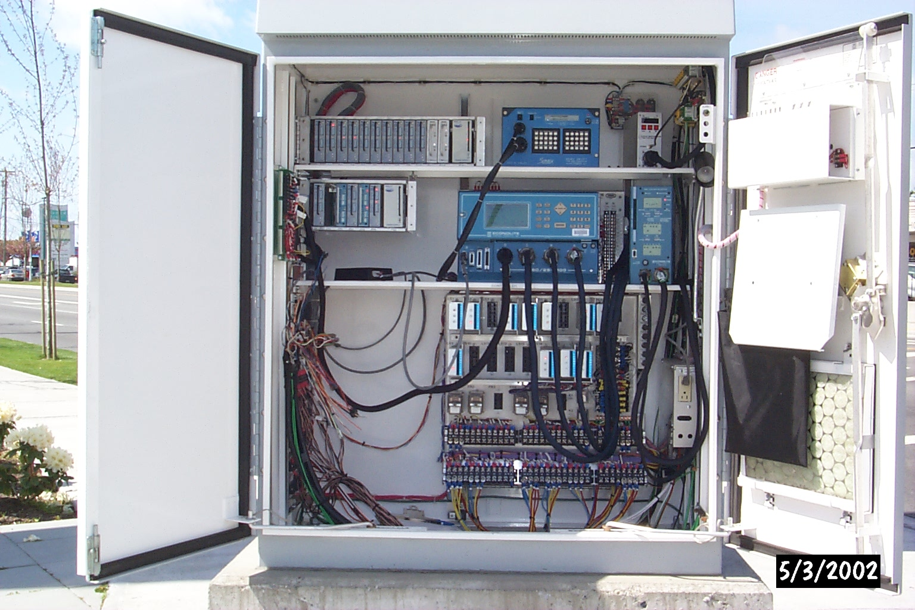


What is “SMART”?
STAGE 1: Instrumentation
STAGE 2: Connections
STAGE 3: Data & Analytics

Slide 5
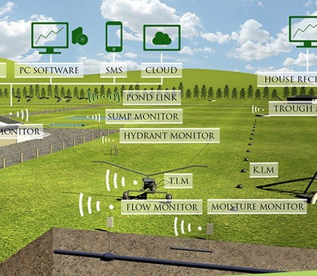
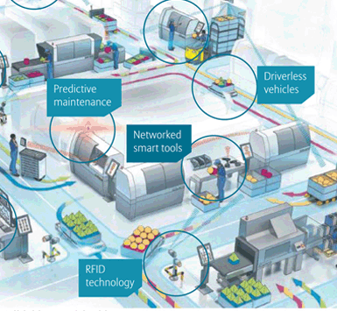
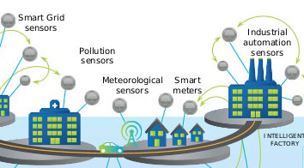
The basics of “SMART” work for everything

Slide 6
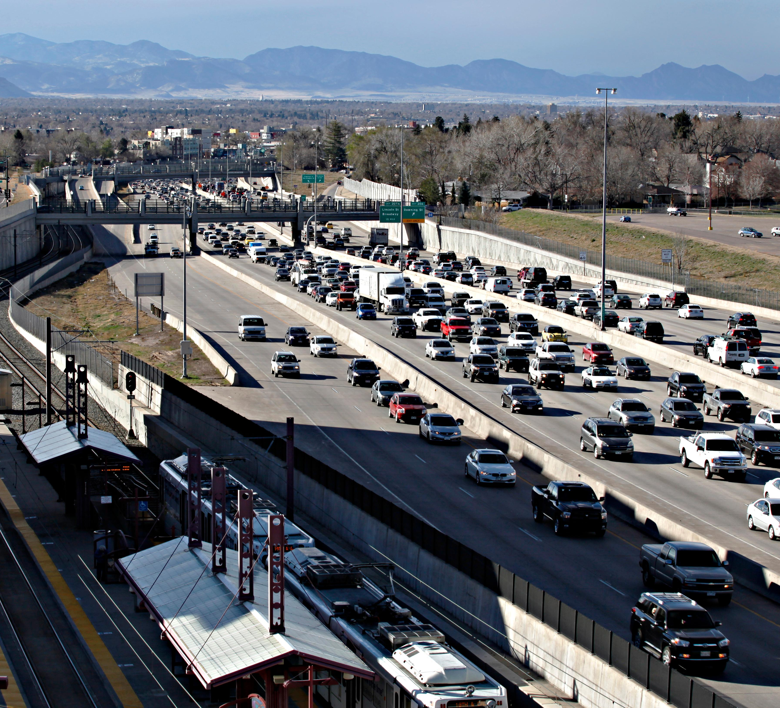
Building smarter cities

Slide 7
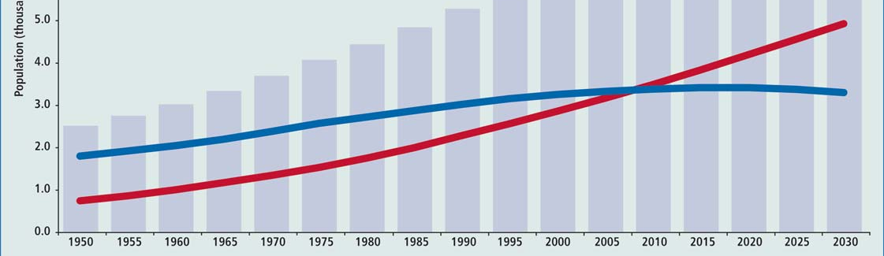
Why Smart Cities?
Notes:
Because the urbanization of the world is only going to continue. Already we have crossed the tipping point.
Africa, the last major continent to do so, will cross it in 2035

Slide 8
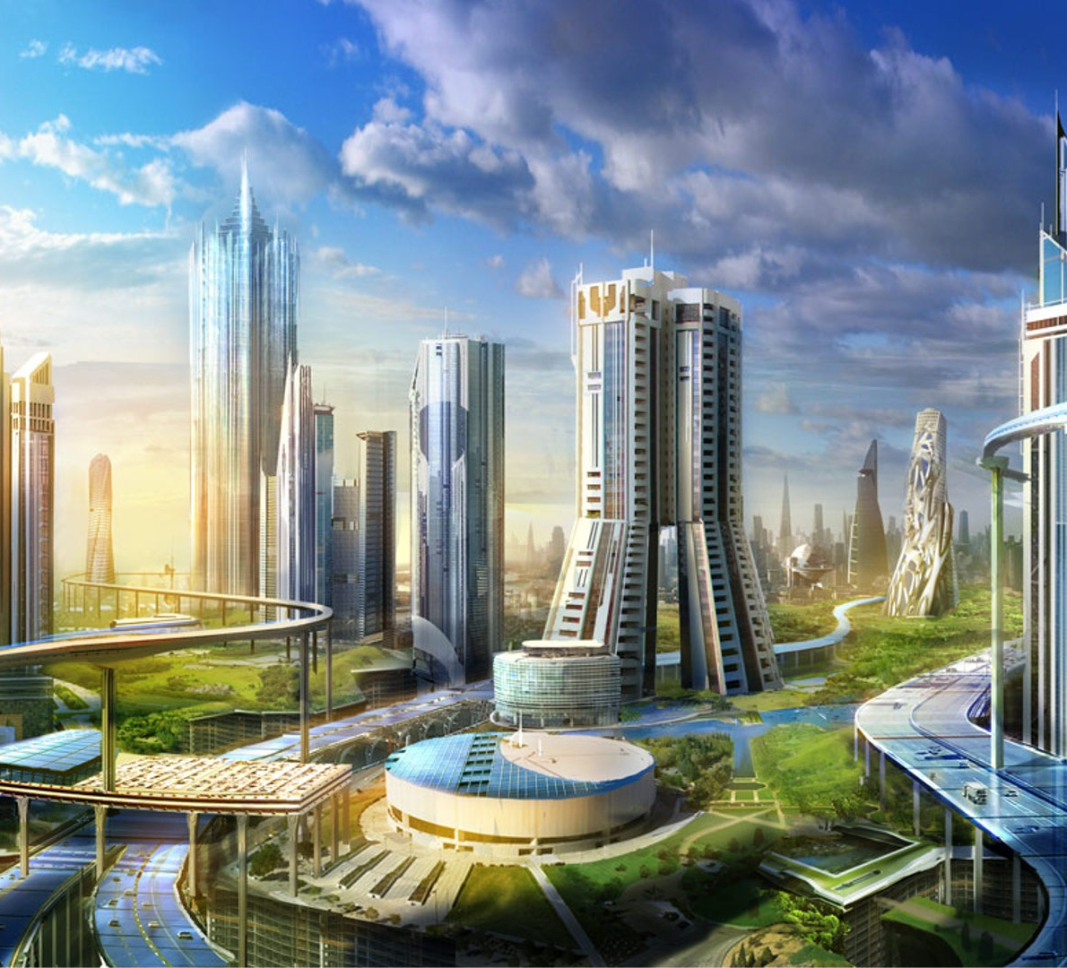
What’s stopping this utopia?

Slide 9
How can we fix it?
STAGE 4: Automating
Notes:
We are bad at letting go of control as humans, but until we do there is no “smart city” only an intelligent city, with a bunch of really dumb citizens.

Slide 10
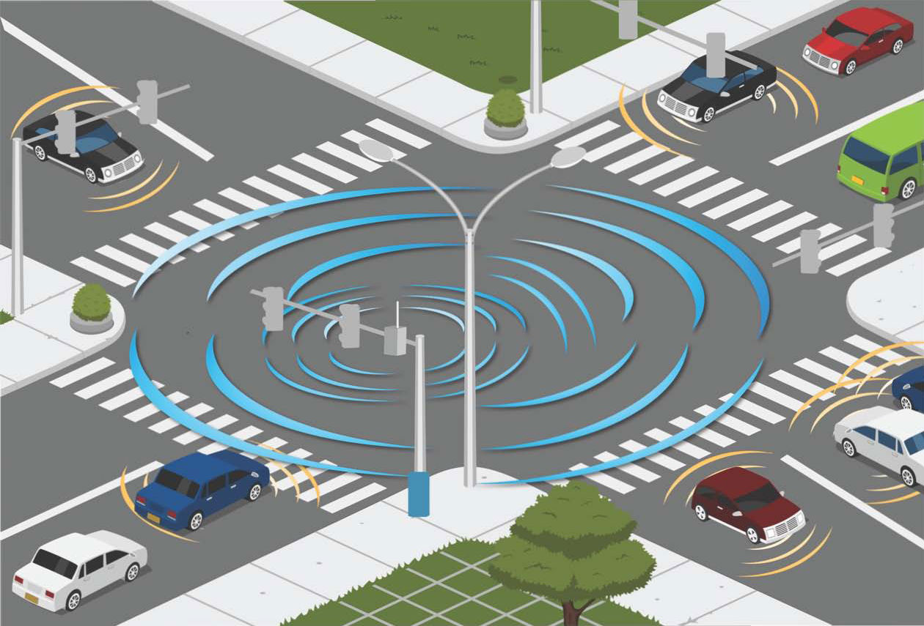
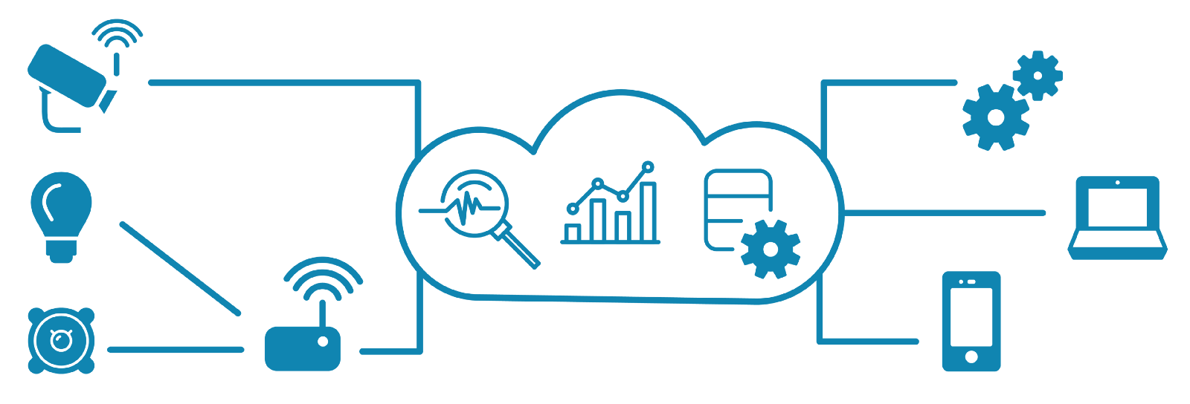
What are we building today?
Devices
Data Stores
Gateway(s)
Interfaces
Notes:
Replace street with conveyor belt and you have the genesis of smart manufacturing. Replace it with corn on a conveyor at a grain silo and you have smart agriculture. Fundamental technology on any scale is the foundation of ALL of the IoT. It isn’t rocket science.

Slide 11
Step 1: Hardware
Don’t let the smoke out

Slide 12
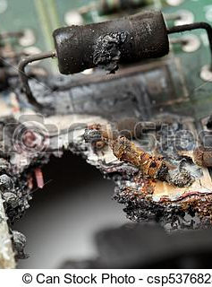
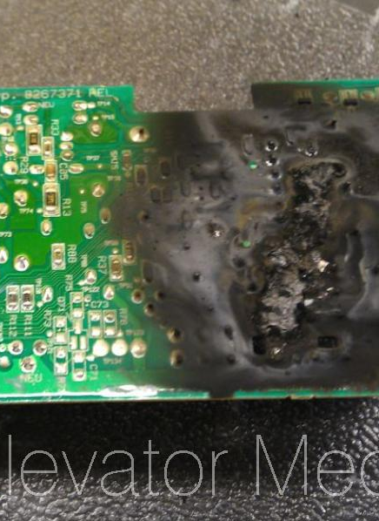
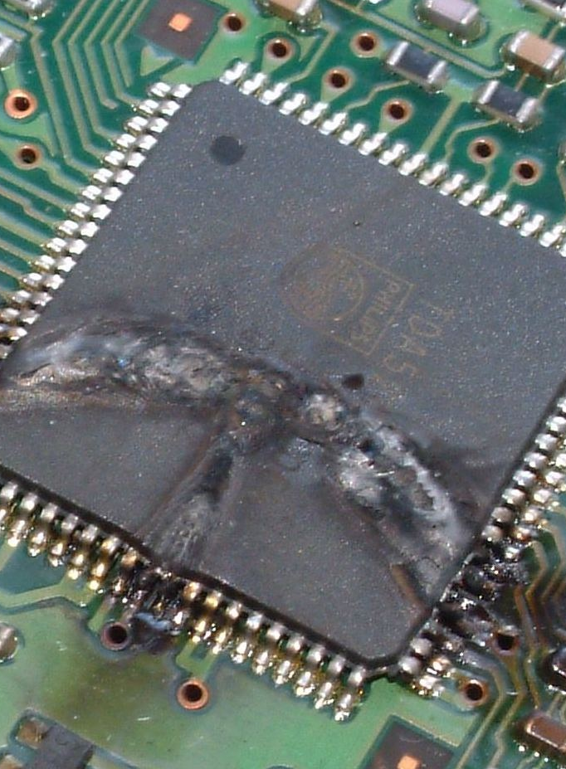
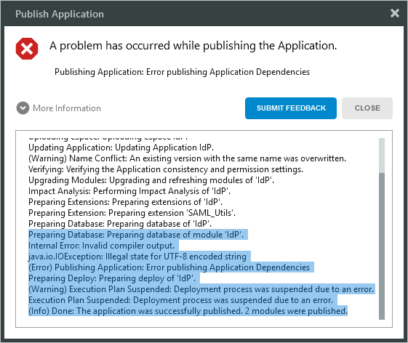

Why is hardware scary?
Software errors are “soft”
Hardware errors on the other hand….
ELECTRICITY KILLS PEOPLE!
Notes:
Getting over working with hardware

Slide 13
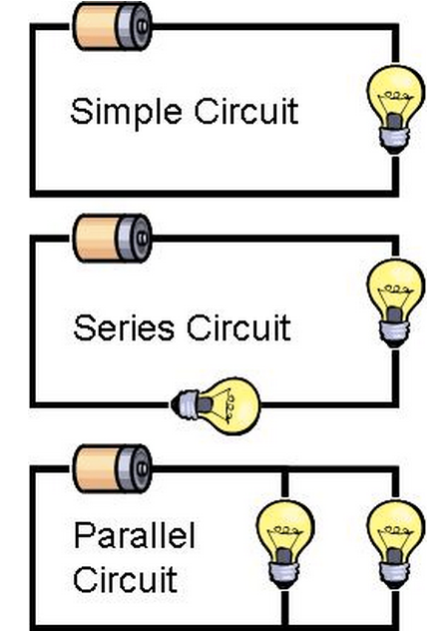
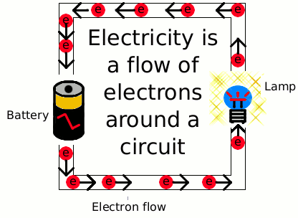
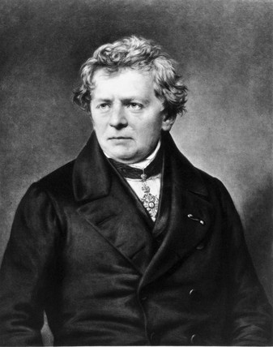

Electricity fundamentals
Electricity is flowing electrons
Flow is channeled through circuits, like water through plumbing
Flow is governed by Ohm’s law:
Voltage (Pressure)
Current (Amperes – same as Speed)
Resistance (Diameter of the pipes)
Notes:
Wiring is a lot like plumbing
Power out or - terminal is the “faucet”
Ground or the + terminal is the “drain”
Ohm did his work on resistance in the years 1825 and 1826, and published his results in 1827 as the book Die galvanische Kette, mathematisch bearbeitet ("The galvanic circuit investigated mathematically").[

Slide 14
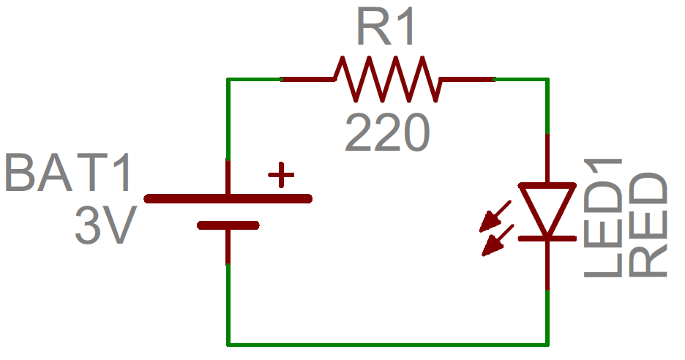

Control Over electricity
To flow, electricity needs a source and a ground
The NodeMCU provides multiple sources and grounds
Note which one your project requires!
All amps are in milli-amps and 3 or 5 V
You are now one of the X-Men
*Inclusion in X-Men adventures not guaranteed
Notes:
Mention the 3v 5v issue with Jerry Bot

Slide 15
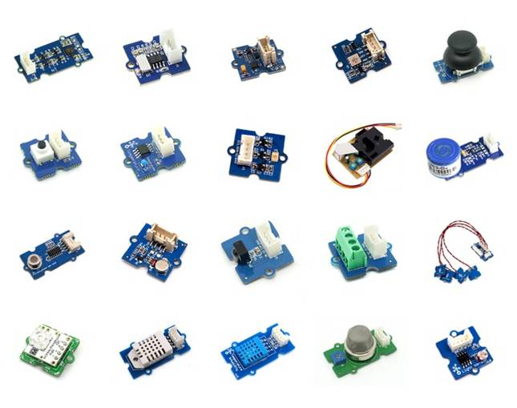
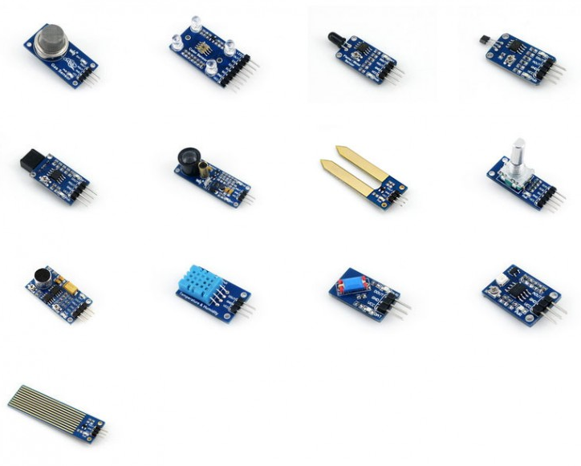
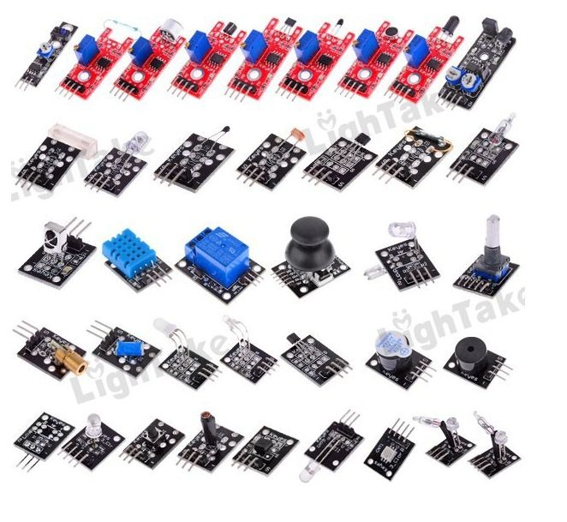
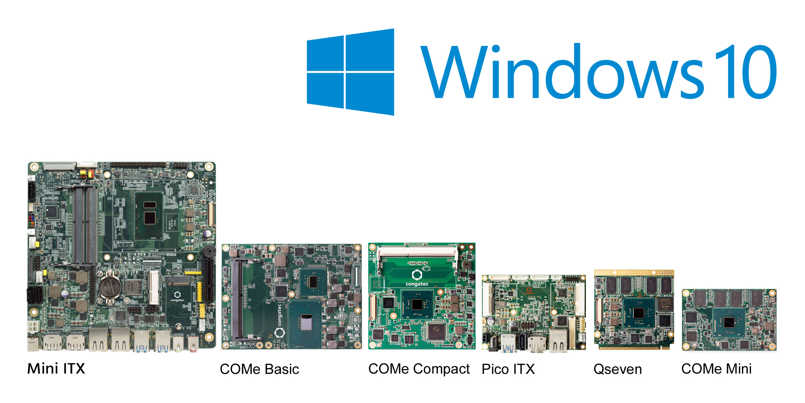
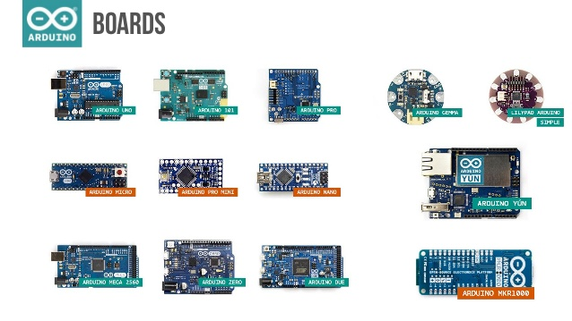
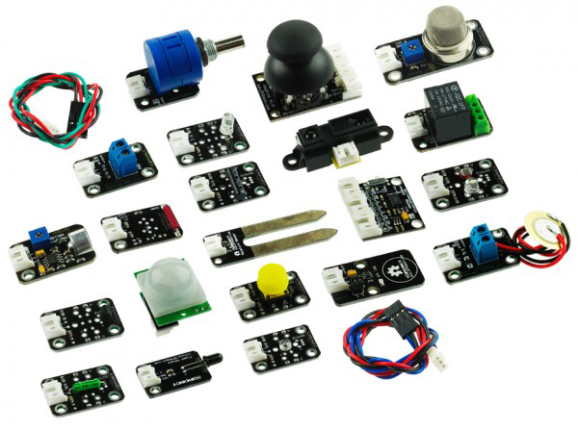
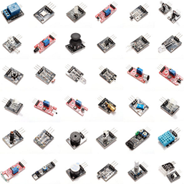
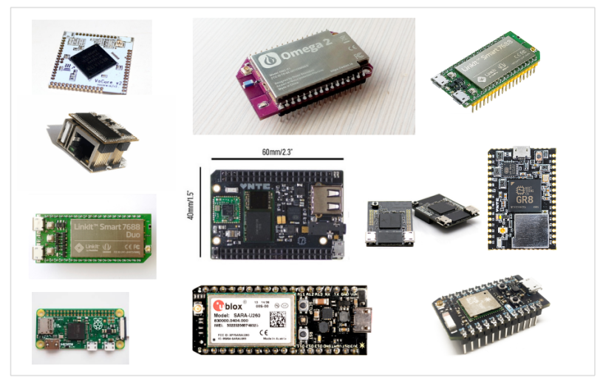
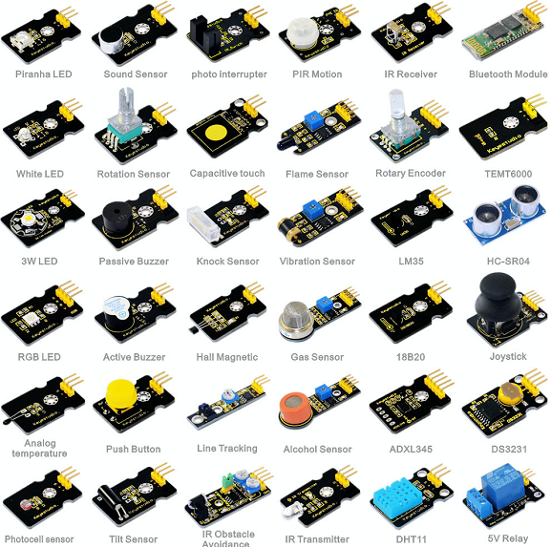
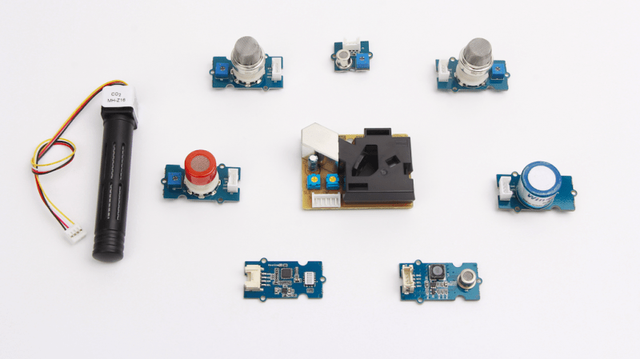
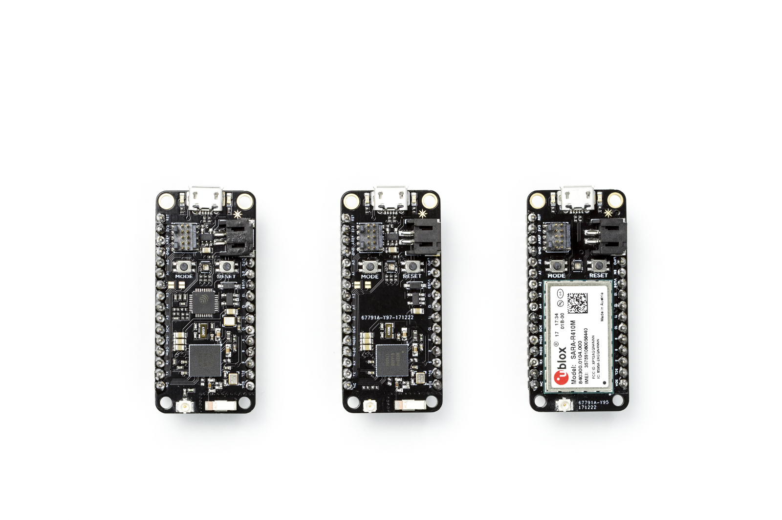
Hardware Overload
Notes:
Second reason hardware is kind of challenging? Where do you start?

Slide 16
Step 2: Software
Multi-discipline approaches to IOT

Slide 17
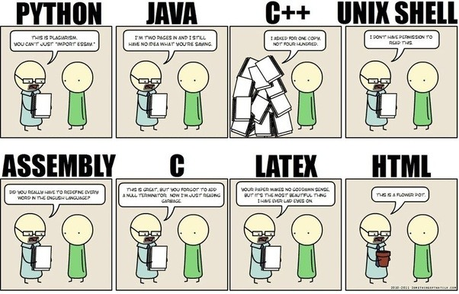

IoT (often) Requires MANY languages

Slide 18
Why so many languages?
“Easy” Code
NodeRed/JAVA
Easy Code:
Agile, common, simple, approachable, good for prototyping
“Good” Code
THE RIGHT CODE FOR EACH PURPOSE
“Fast” Code
Asembly/C++
Fast Code:
Real-time, interrupt drive, time-sensitive, super lightweight
Notes:
If we assume that all code is or should be “good” then you simply choose fast or easy for the purpose in mind

Slide 19
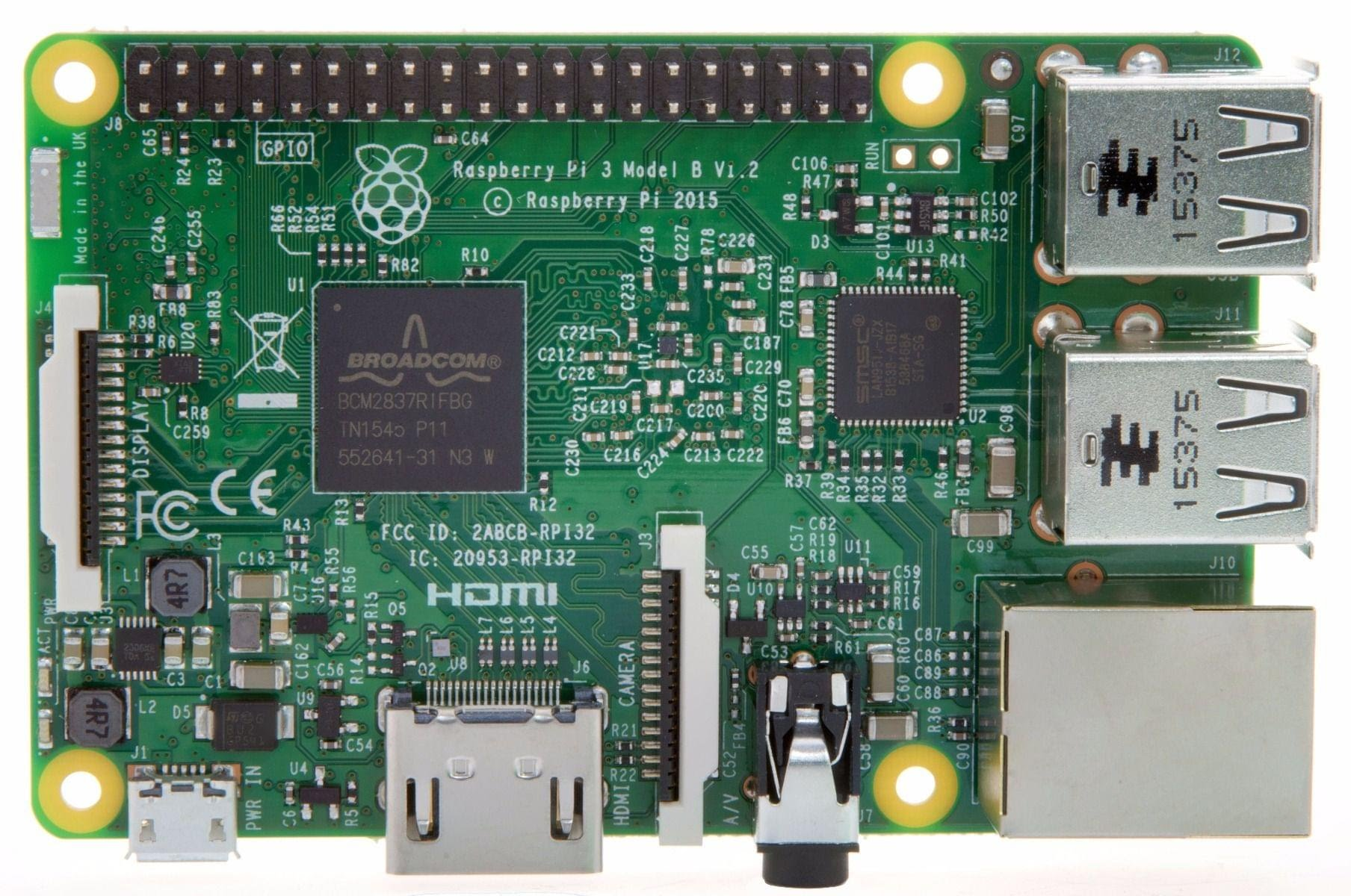
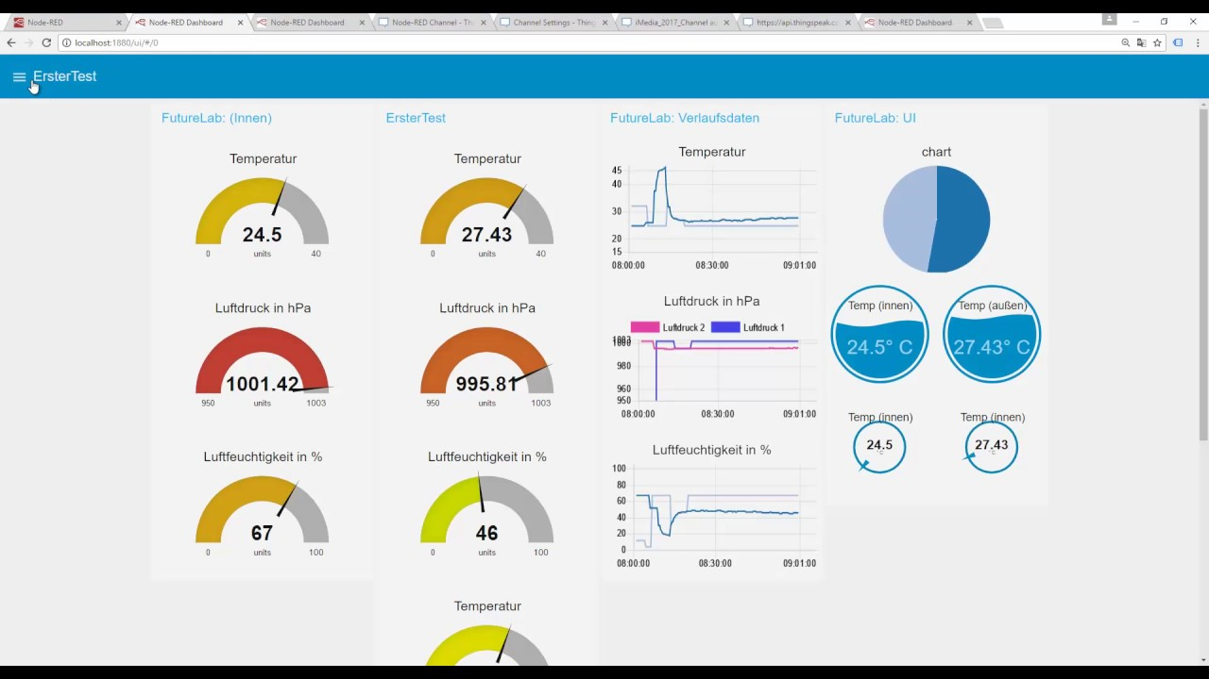
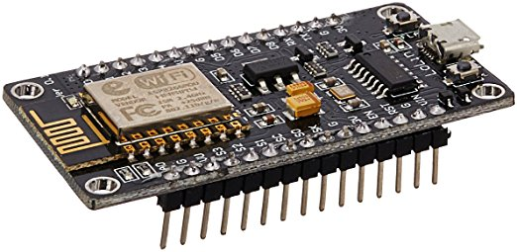
What goes where?
SENSORS
UI – Java &HTML
RaspberryPi – NodeRed and MQTT
x8
ESP8266 – C/C++
RaspberryPi – MYSQL (MariaDB)

Slide 21
Let’s Build it!
Simple smart anything sensor pack

Slide 22
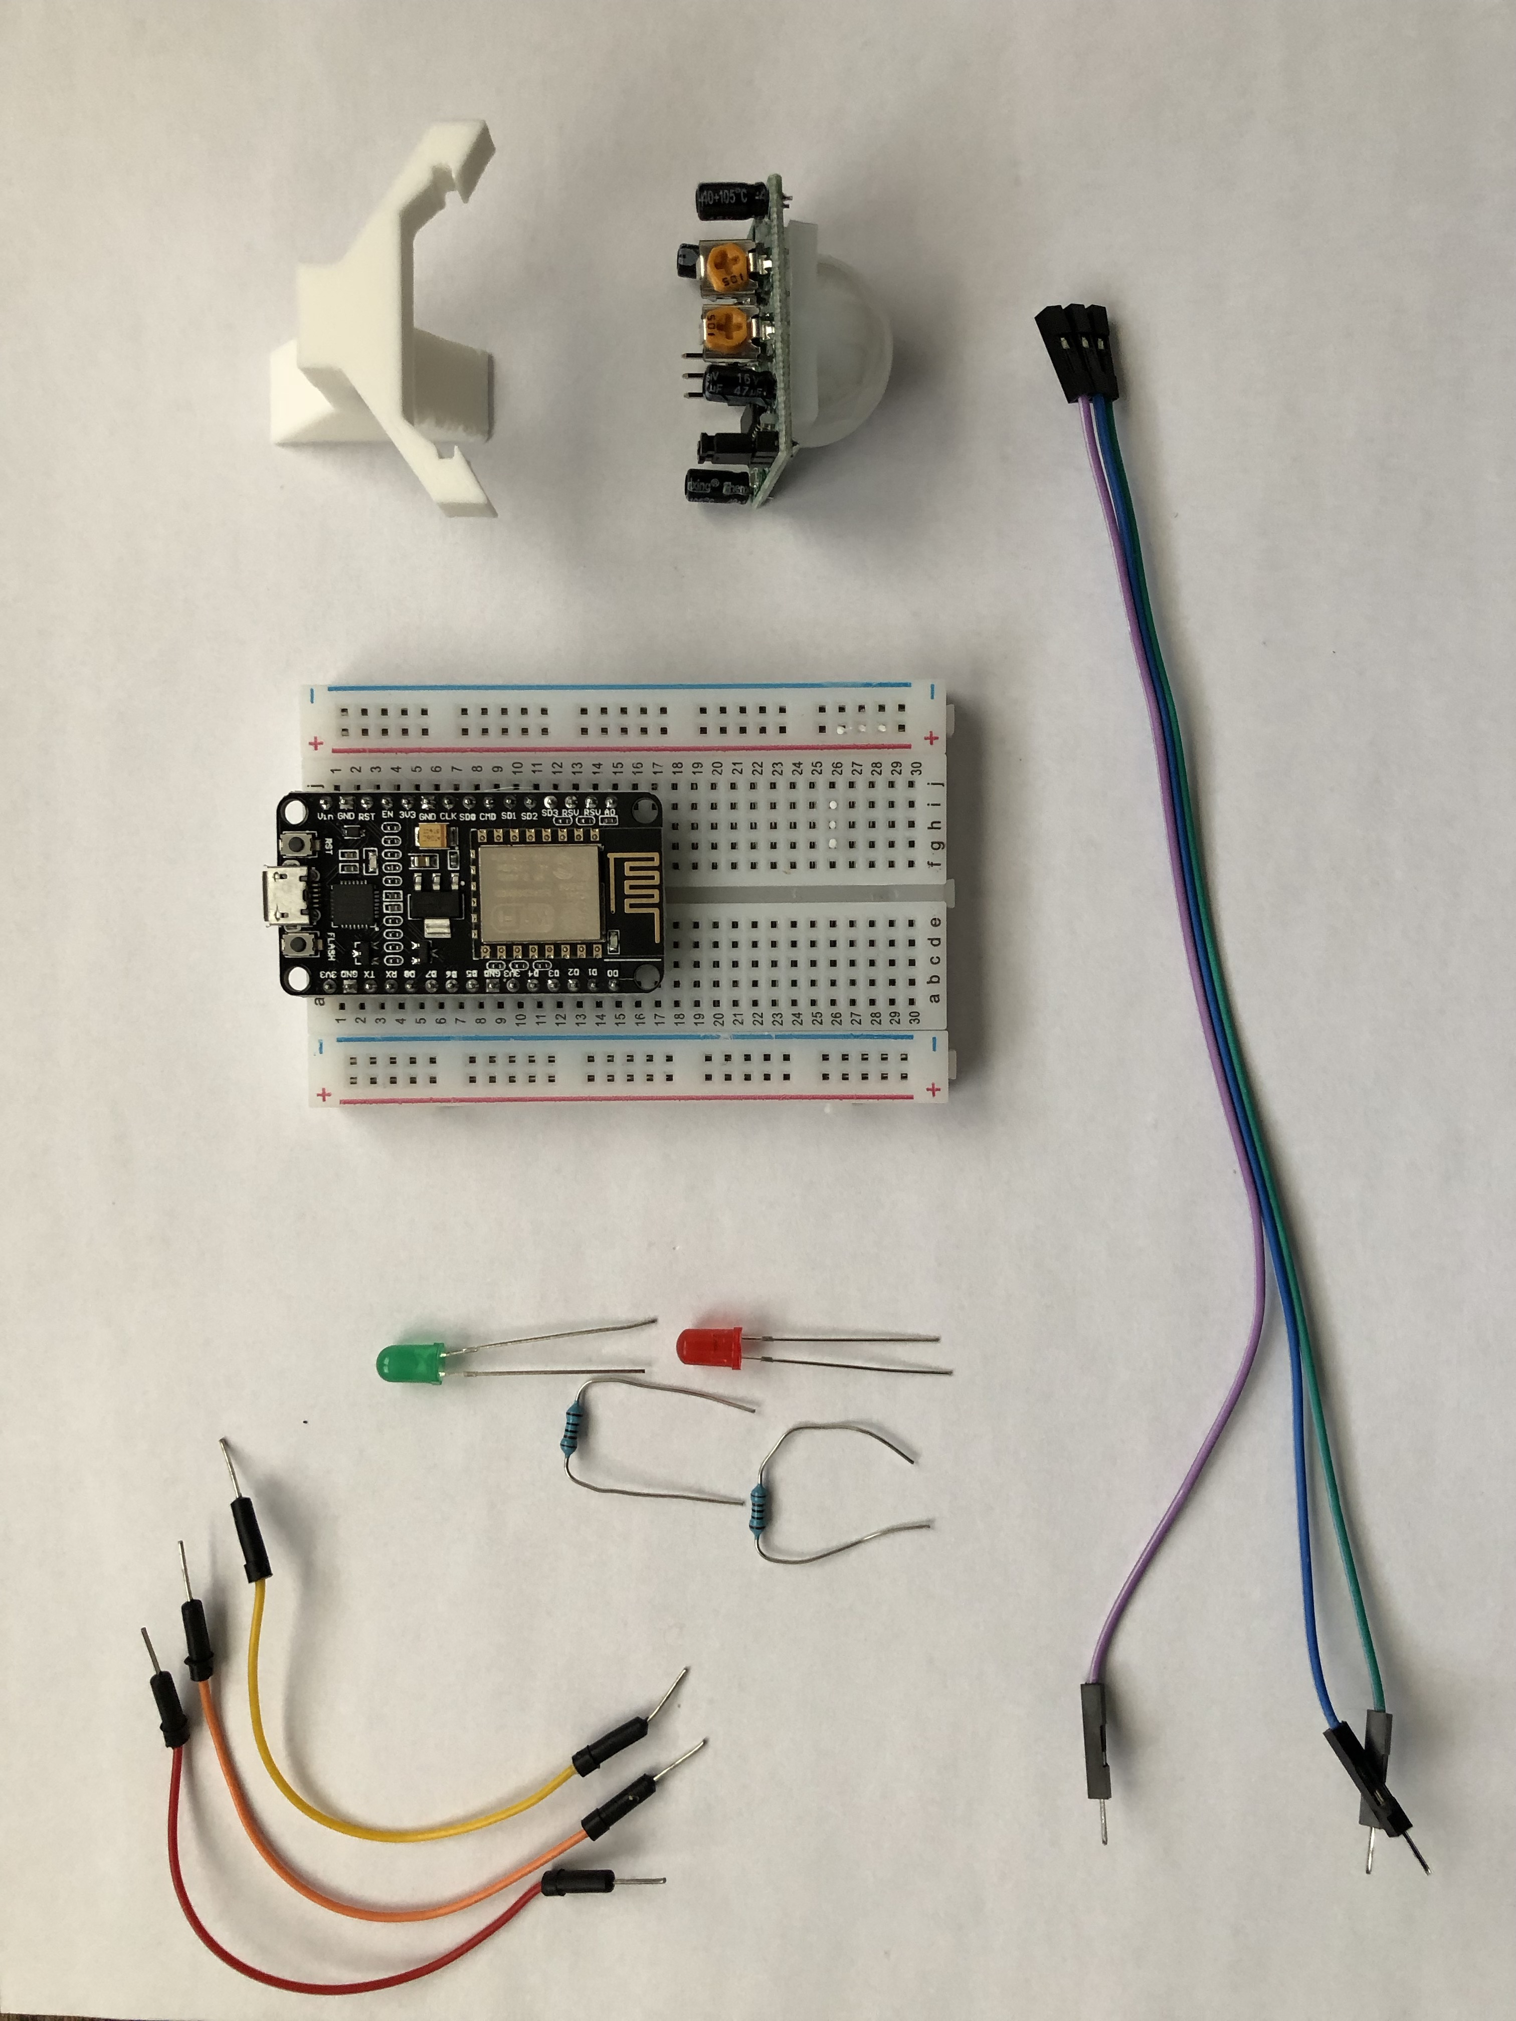
OUR Hardware – AKA What’s in this box!?
Basic hardware required to build our project
Breadboard
Wires
Lights
Resistors
IR Sensor and stand
NodeMCU

Slide 23
Node MCU (esp8266)
Why esp8266?
Inexpensive
Very low Power Consumption
Very small size
Built-in Wireless
Why NOT esp8266?
Programming Support
Only 1 Analog input

Slide 24
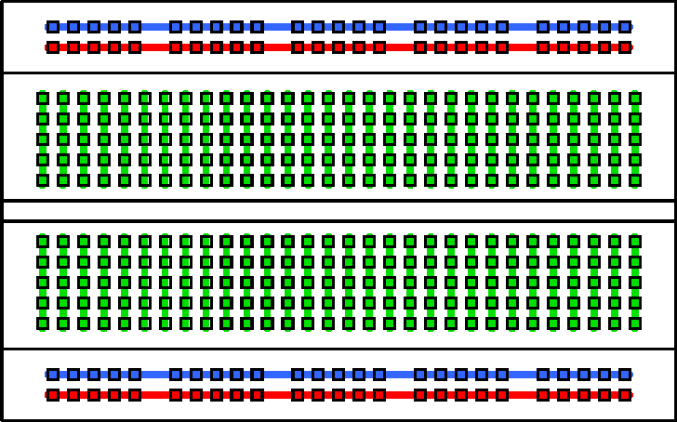
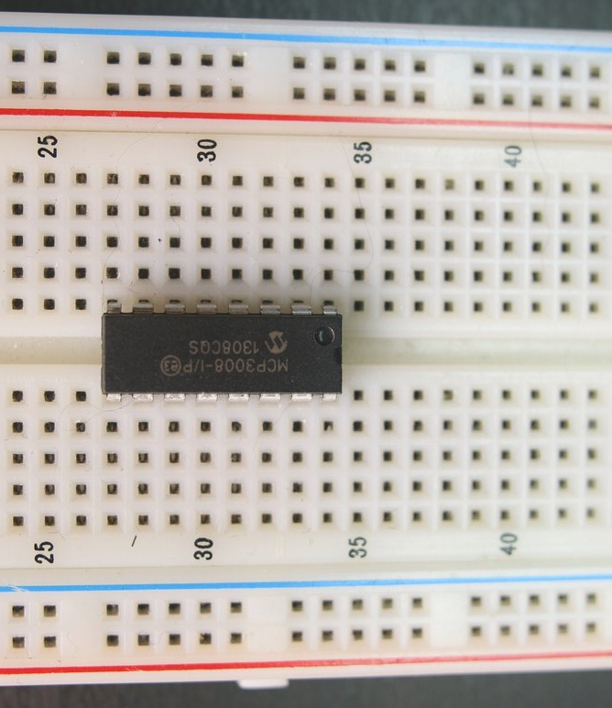
Breadboard basics
IC Chip
Terminal Strips
Columns (#’s)
IC Chip “Ravine”
Rows (Letters)

Slide 25
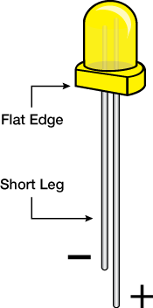
Resistors and LEDs
Notes:
Resistors reduce flow by introducing resistance to the electrical current
Graded in value of that resistance (OHMS)
Governed by Ohms law
LED lights make light through magic – small leg is the Ground side

Slide 26
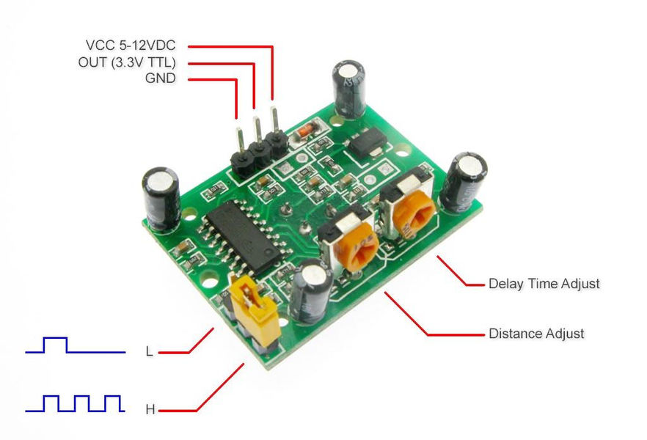
SENSOR Basics
Common Sensor pinout:
VCC = power IN
GND = power OUT (Ground)
Out(put) = signal out
Sometimes you also get:
A0 = Analog output
D0 = Digital output

Slide 27
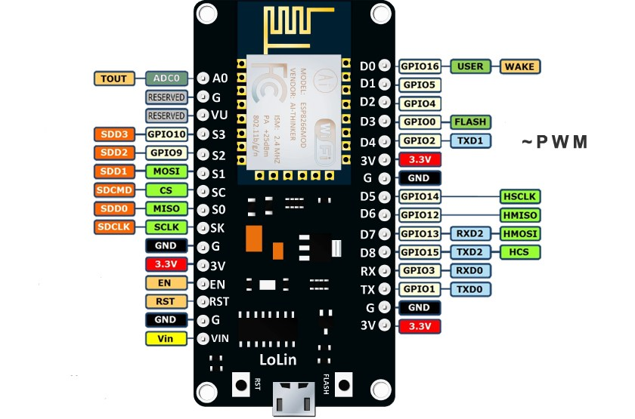
A pinout ‘splainer
Power
Ground
GPIO
Alternate Functions
Notes:
Page 7 in the companion
Refer back to the electricity slide – every one of these pins is effectively a battery “-” sign – some are on all the time and some you control. They can go in or out.

Slide 28
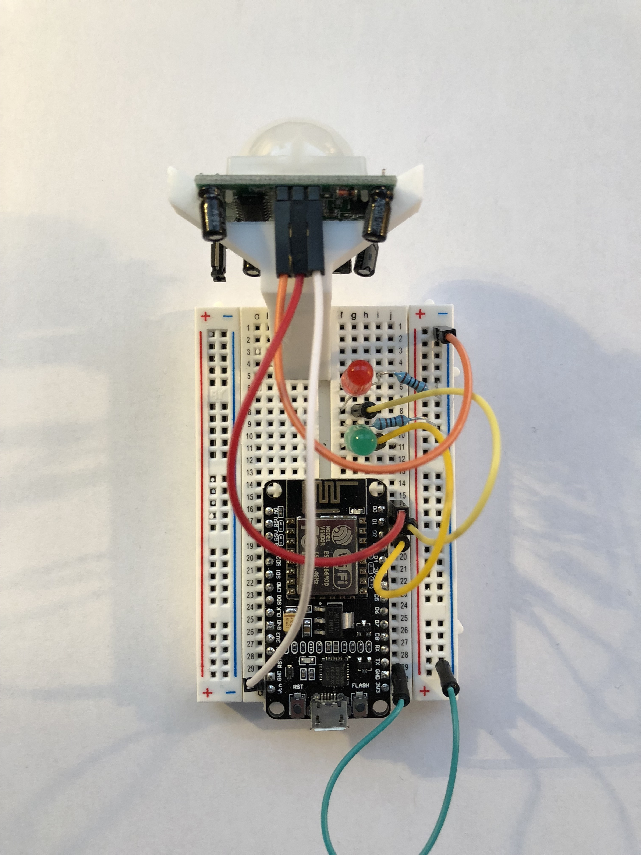
Putting it all together
KISS – keep it simple, son!
If it works:
Green light on
Switch to red if you move your hand in front of the sensor
Wiring issues?
Notes:
During the build, talk about things like:
Prototype vs commercial
Screwing around versus functional building
Long-term things you can do to get serious

Slide 29
Device Software
Triggers and collectors

Slide 30

Let’s Review the code!
http://bit.ly/IoT-c-code

Slide 31
The Stage 2 Smart City
Working together

Slide 32

Get Connected!
Sensors working together to coordinate events is SMART!

Slide 33
NodeRed – Aggregating devices
Simple “block based” tool for building data flows
Designed with IOT in mind
Excellent tool for going from prototype to production*

Slide 34
Let’s Review the code!
Connect to your group’s NodeRed instance:
http://192.168.1.xxx:1880

Slide 36
A “Smart” intersection

Slide 37

Group activity

Slide 38

What’s Next?
Group Brainstorming
What would you try next?
Think outside your own intersection!

Slide 39

Wrap up

